Slide 1
Food processing updates
Notes:
Stock image of cloud formations

Slide 2
Updates and current status
Updates since the spring
Added infilling of energy use data for food processing for regions where data are limited; also infilled non-CO₂ emissions data for consistency
Added an electric heat pump technology and solar-equipped gas and electric technologies
Updated global technology non-energy costs for process heat food processing technologies
Broke out water use for the food processing sector
Merged in GCAM 7 and ensured compatibility with the macro module
Updated CMP – describes all development performed so far
Pending to-dos
Update non-energy costs for the overall food processing sector
Validation runs and pull request

Slide 3
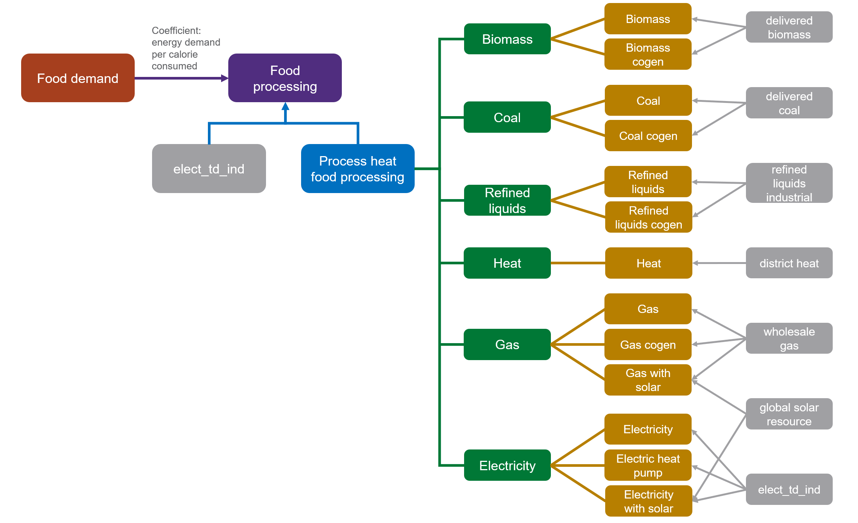
Sector structure
Notes:
As the food processing sector is one of the industrial sectors thought to have relatively high potential for use of solar thermal energy, we also model two solar-equipped technologies, gas with solar and electricity with solar (IEA-ETSAP & IRENA, 2015; Schoeneberger et al., 2020; Sharma et al., 2017; Taibi et al., 2012). These are represented as technologies that combine a solar thermal system with another source of process heat, as solar thermal units are unlikely to be able to supply all the necessary process heat demand (even when paired with storage) due to variation in solar radiation intensity (IEA-ETSAP & IRENA, 2015; McMillan et al. 2021). PTCs can be designed to produce low to medium-high temperature heat. Though most heat demands in the food processing sector are for relatively low temperature heat (<120 degrees C)–which can also be produced using other, lower cost collector types–we make a conservative estimate in using the higher costs associated with PTCs to ensure that all heat demands for the sector can potentially be covered by this representative technology and because some existing analyses have considered and/or implemented these collectors in solar themal systems for the food processing sector (Arpagaus et al., 2018; Schoeneberger et al., 2020; IEA-ETSAP & IRENA, 2015; Sharma et al., 2018). For solar-equipped technologies, the solar fraction (fraction of energy supplied by the solar thermal system) is assumed to be 0.2, as literature values range from 0.14-0.6 depending on the type of solar collector and location, but with most values in the 0.15-0.3 range (Allouhi et al., 2017; IEA-ETSAP & IRENA, 2015; Kurup & Turchi, 2019; McMillan et al., 2021; Meyers et al., 2018; Sharma et al., 2018).

Slide 4
Sector structure
Updated global technology non-energy costs for process heat food processing technologies
Added an electric heat pump technology and solar-equipped gas and electric technologies
Electric heat pumps are modeled consistently with those in the pulp and paper sector
Solar-equipped technologies are modeled based on gas/electric boilers + parabolic trough collectors
Notes:
As the food processing sector is one of the industrial sectors thought to have relatively high potential for use of solar thermal energy, we also model two solar-equipped technologies, gas with solar and electricity with solar (IEA-ETSAP & IRENA, 2015; Schoeneberger et al., 2020; Sharma et al., 2017; Taibi et al., 2012). These are represented as technologies that combine a solar thermal system with another source of process heat, as solar thermal units are unlikely to be able to supply all the necessary process heat demand (even when paired with storage) due to variation in solar radiation intensity (IEA-ETSAP & IRENA, 2015; McMillan et al. 2021). PTCs can be designed to produce low to medium-high temperature heat. Though most heat demands in the food processing sector are for relatively low temperature heat (<120 degrees C)–which can also be produced using other, lower cost collector types–we make a conservative estimate in using the higher costs associated with PTCs to ensure that all heat demands for the sector can potentially be covered by this representative technology and because some existing analyses have considered and/or implemented these collectors in solar themal systems for the food processing sector (Arpagaus et al., 2018; Schoeneberger et al., 2020; IEA-ETSAP & IRENA, 2015; Sharma et al., 2018). For solar-equipped technologies, the solar fraction (fraction of energy supplied by the solar thermal system) is assumed to be 0.2, as literature values range from 0.14-0.6 depending on the type of solar collector and location, but with most values in the 0.15-0.3 range (Allouhi et al., 2017; IEA-ETSAP & IRENA, 2015; Kurup & Turchi, 2019; McMillan et al., 2021; Meyers et al., 2018; Sharma et al., 2018).

Slide 5
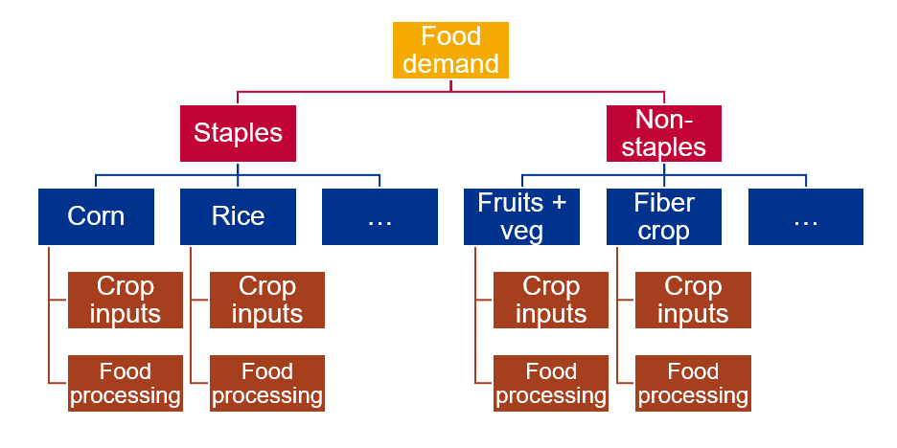
Sector structure
Notes:
The linkage to food demand is accomplished by including an input of food processing to each of the food crop technologies, as shown in the diagram below. In the current implementation, all crops take in one "food processing calorie" per crop calorie (efficiency = 1). However, this could be refined in the future by having varied efficiencies between crops to reflect differences in their average levels of processing, should adequate data on this become available.

Slide 6
Energy use data infilling
For some regions, IEA data on food processing energy use is incomplete, leading to unrealistically low energy use coefficients

Slide 7
Energy use data infilling
Linear model between food processing energy use, calorie consumption and GDP for regions and years from 1990 onwards in which the fraction of total industry energy in non-specified industry energy use is less than 0.5 and the fraction in food processing is greater than 0.01, or even if the non-specified industry fraction is high, the food processing fraction is greater than 0.1

Slide 8
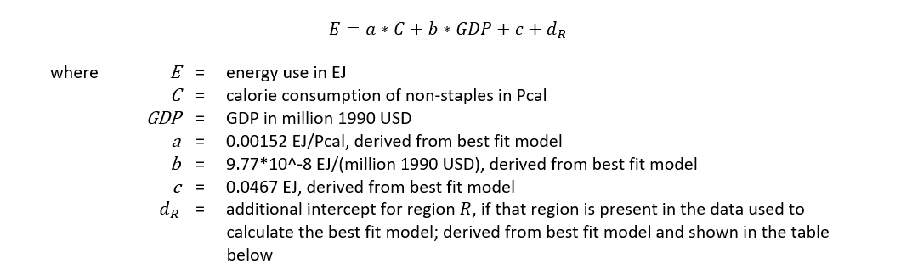
Energy use data infilling
Linear model between food processing energy use, calorie consumption of non-staples, and GDP, incorporating fixed effects, fits the data well and generates reasonable predictions for infilled energy values for regions with limited data

Slide 9
Energy use data infilling
Linear model between food processing energy use, calorie consumption of non-staples, and GDP, incorporating fixed effects, fits the data well and generates reasonable predictions for infilled energy values for regions with limited data
Infilling performed for regions and years from 1990 onwards when the fraction of total industry energy in food processing is less than 0.01, or the fraction in non-specified industry is greater than 0.5 and the fraction in food processing is less than 0.1, and the coefficient of food processing energy use per calorie consumed is less than the minimum value from the data deemed "reasonable" and used to calculate the linear model (0.000413 EJ/Pcal)
Energy to infill is pulled from remaining “other industry” energy use

Slide 10
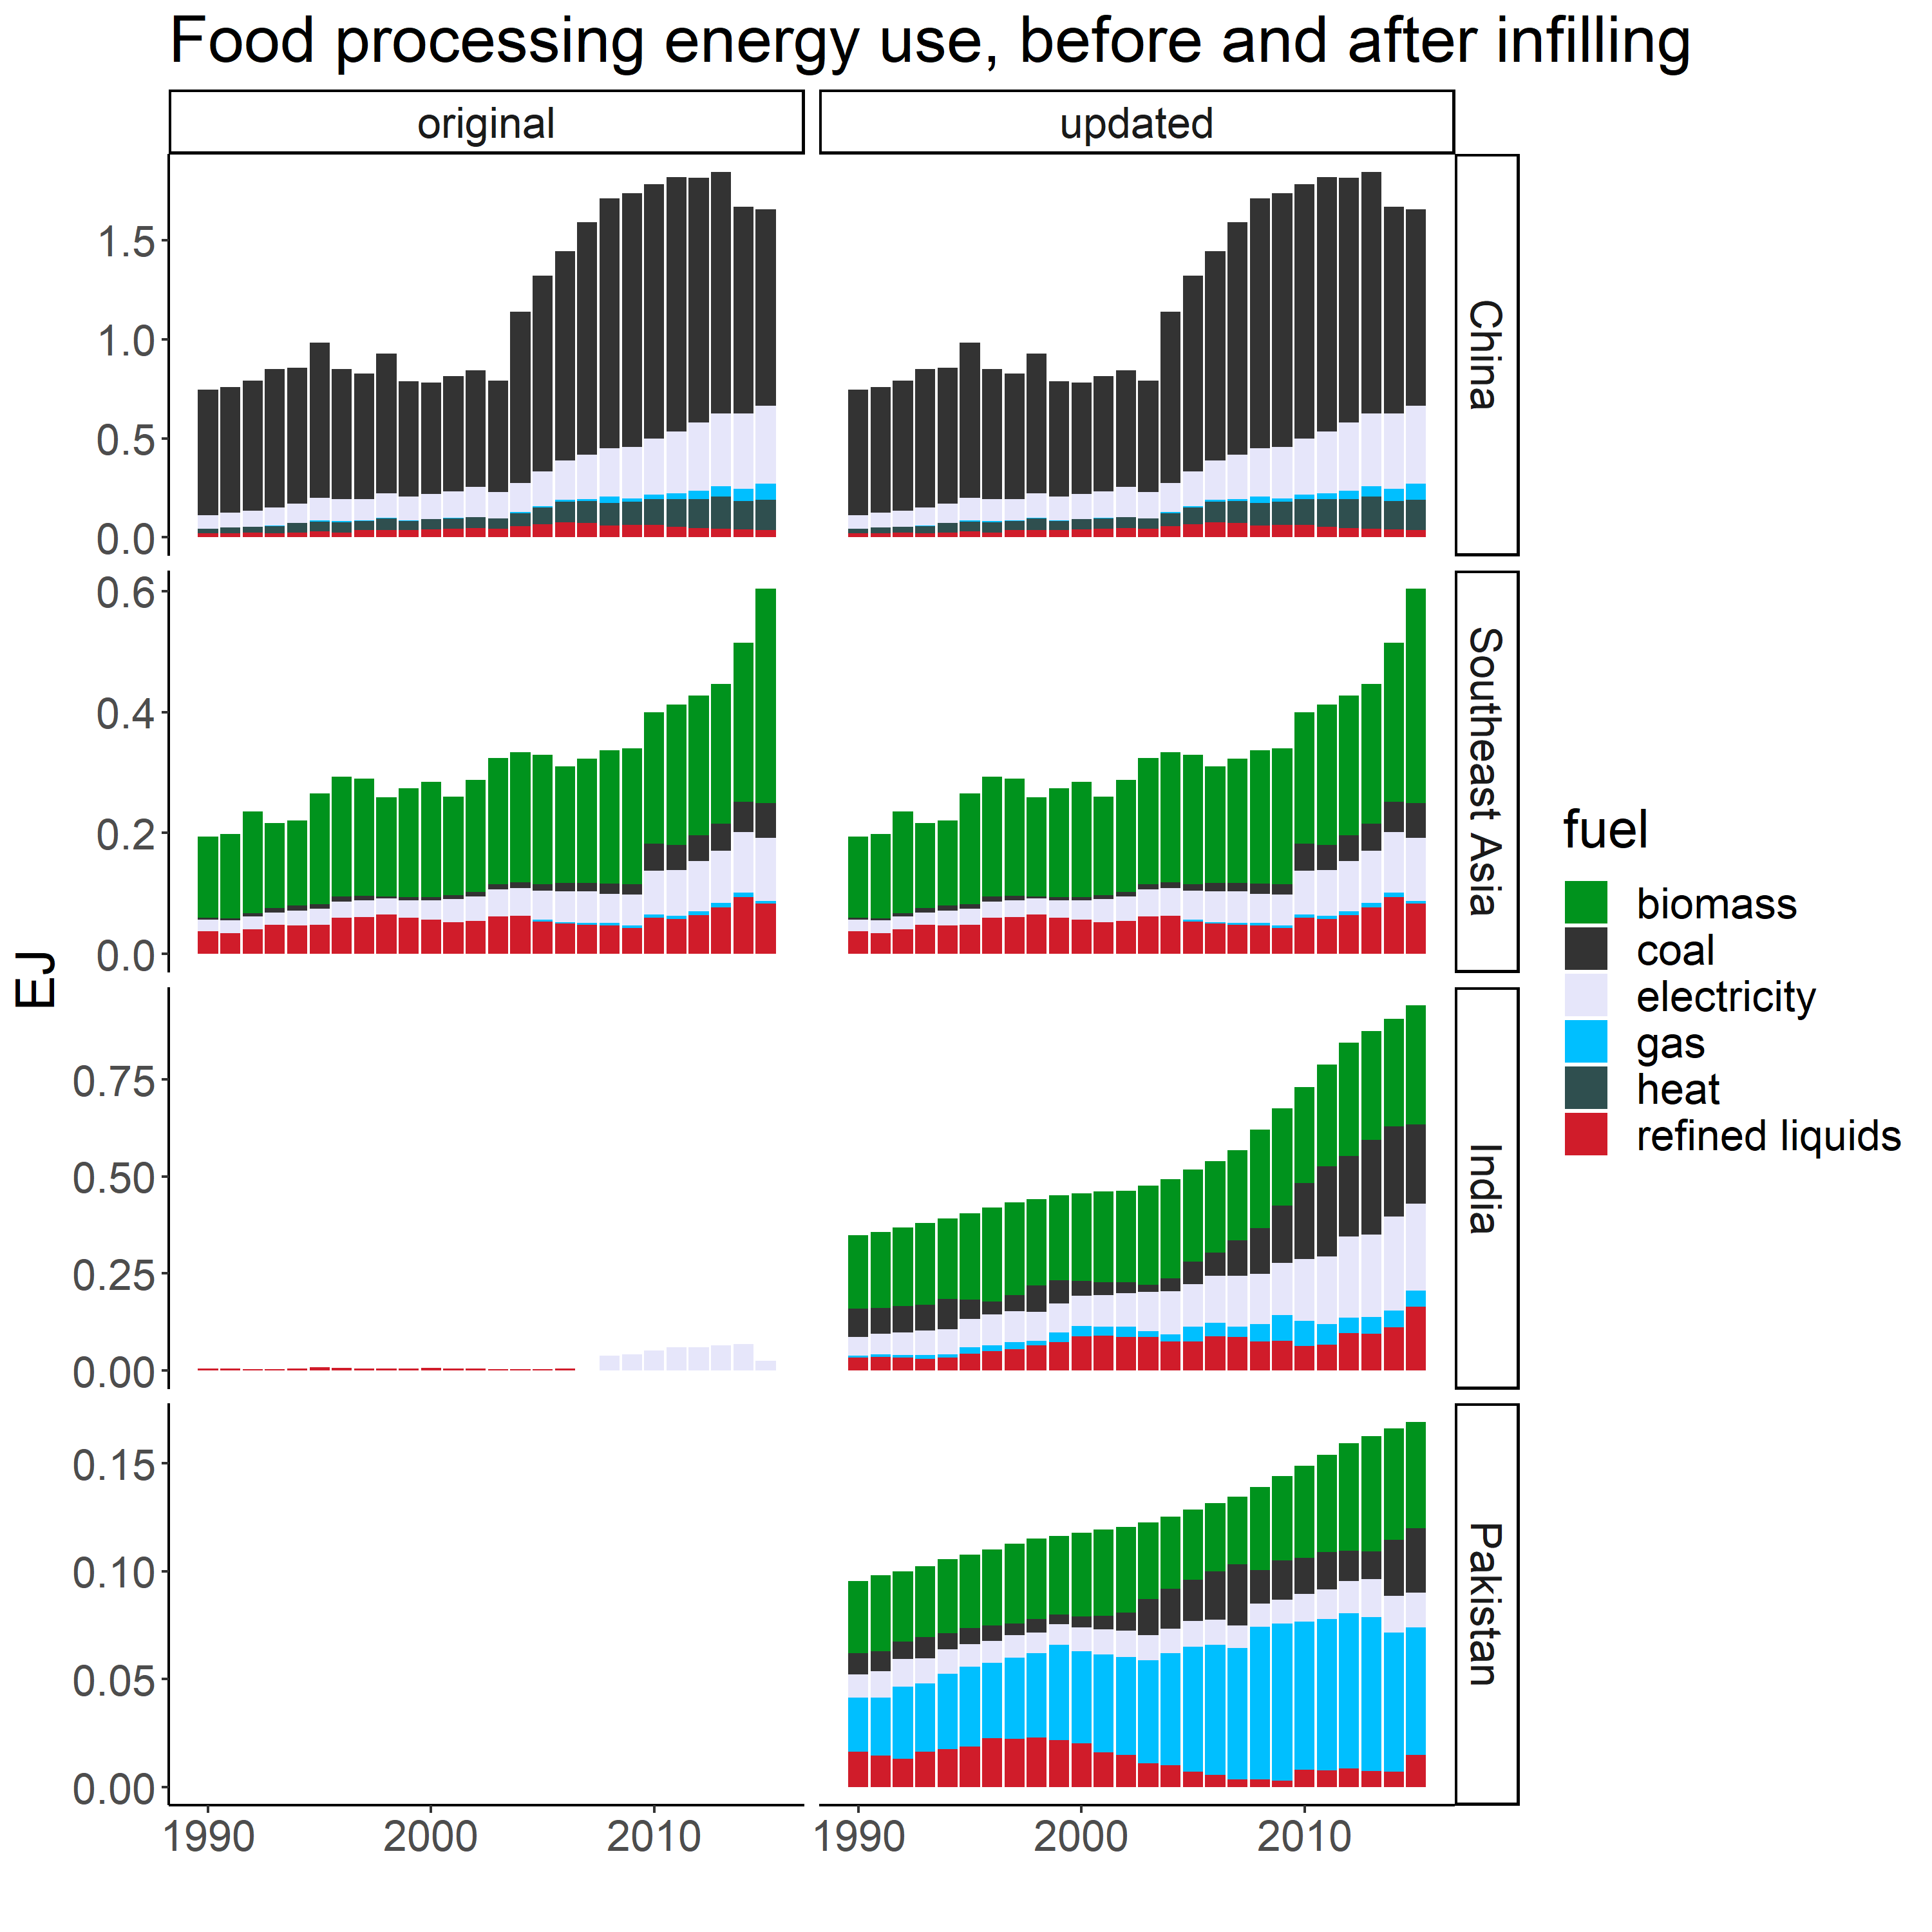
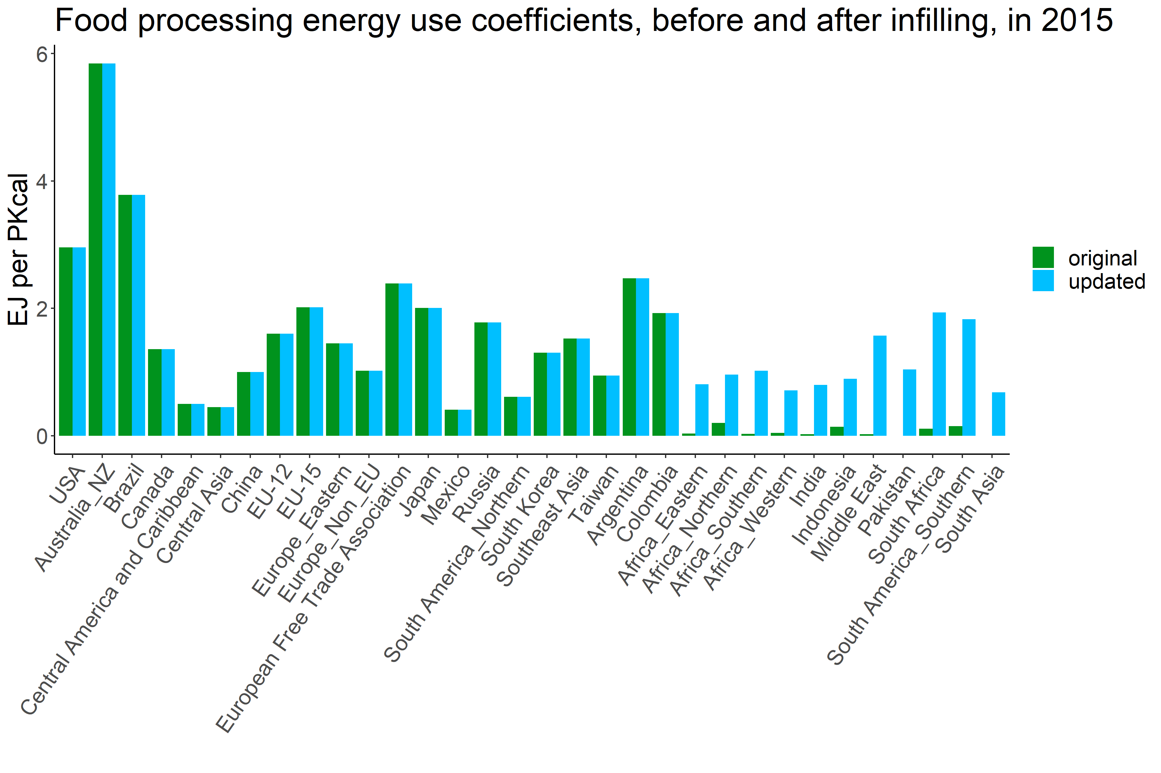
Energy use data infilling

Slide 11
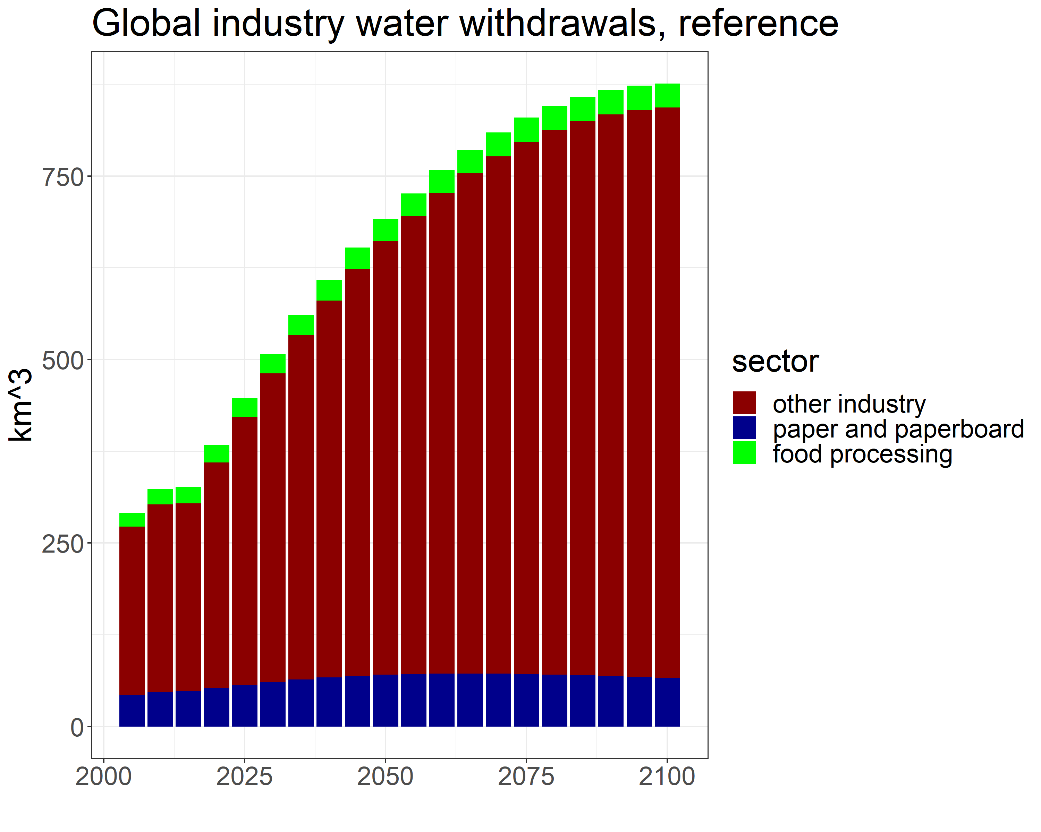
Water use
Food processing sector water withdrawal intensities are calculated for Canada and the United States using food processing industry water withdrawal data paired with calorie consumption data
For all other regions, water withdrawal intensities are obtained by assuming that the level of water use in food processing scales with the level of energy use in food processing; the U.S.’s intensity is used as the benchmark and scaled for each region

Slide 12
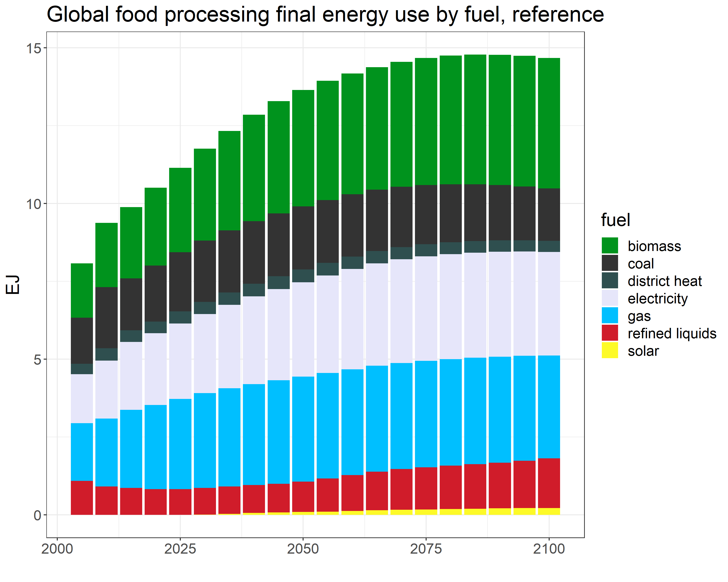
Energy use by fuel

Slide 13
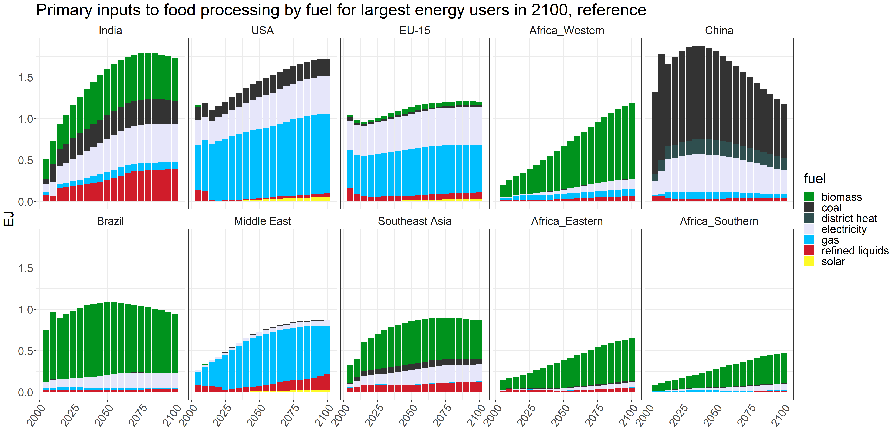
Energy use by fuel

Slide 14
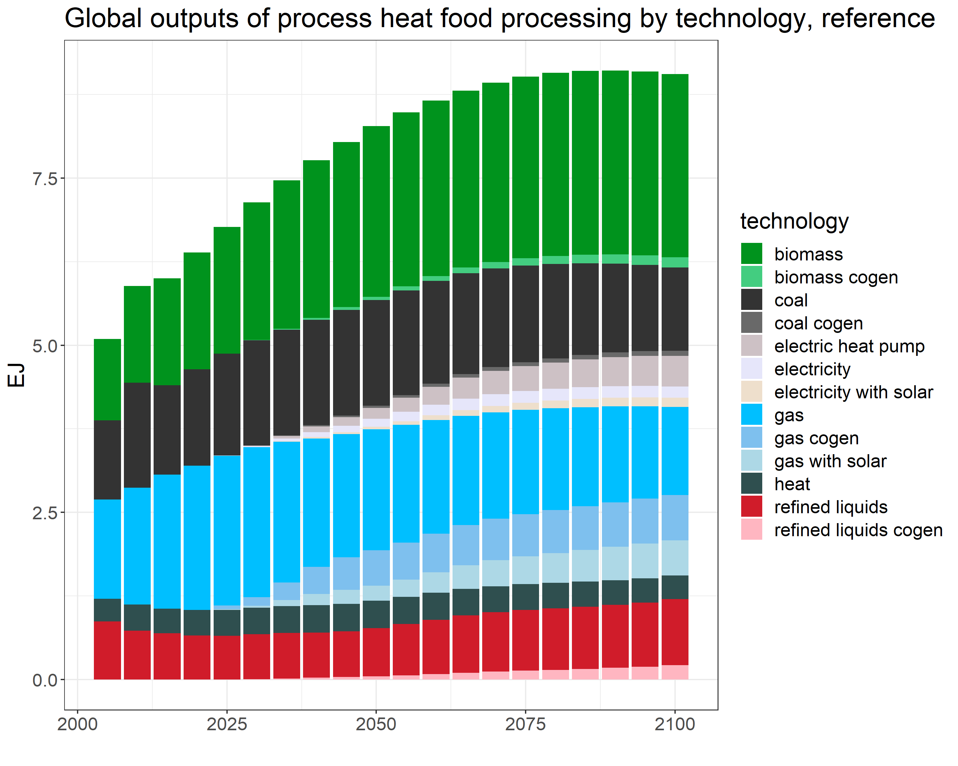
Process heat food processing outputs

Slide 15
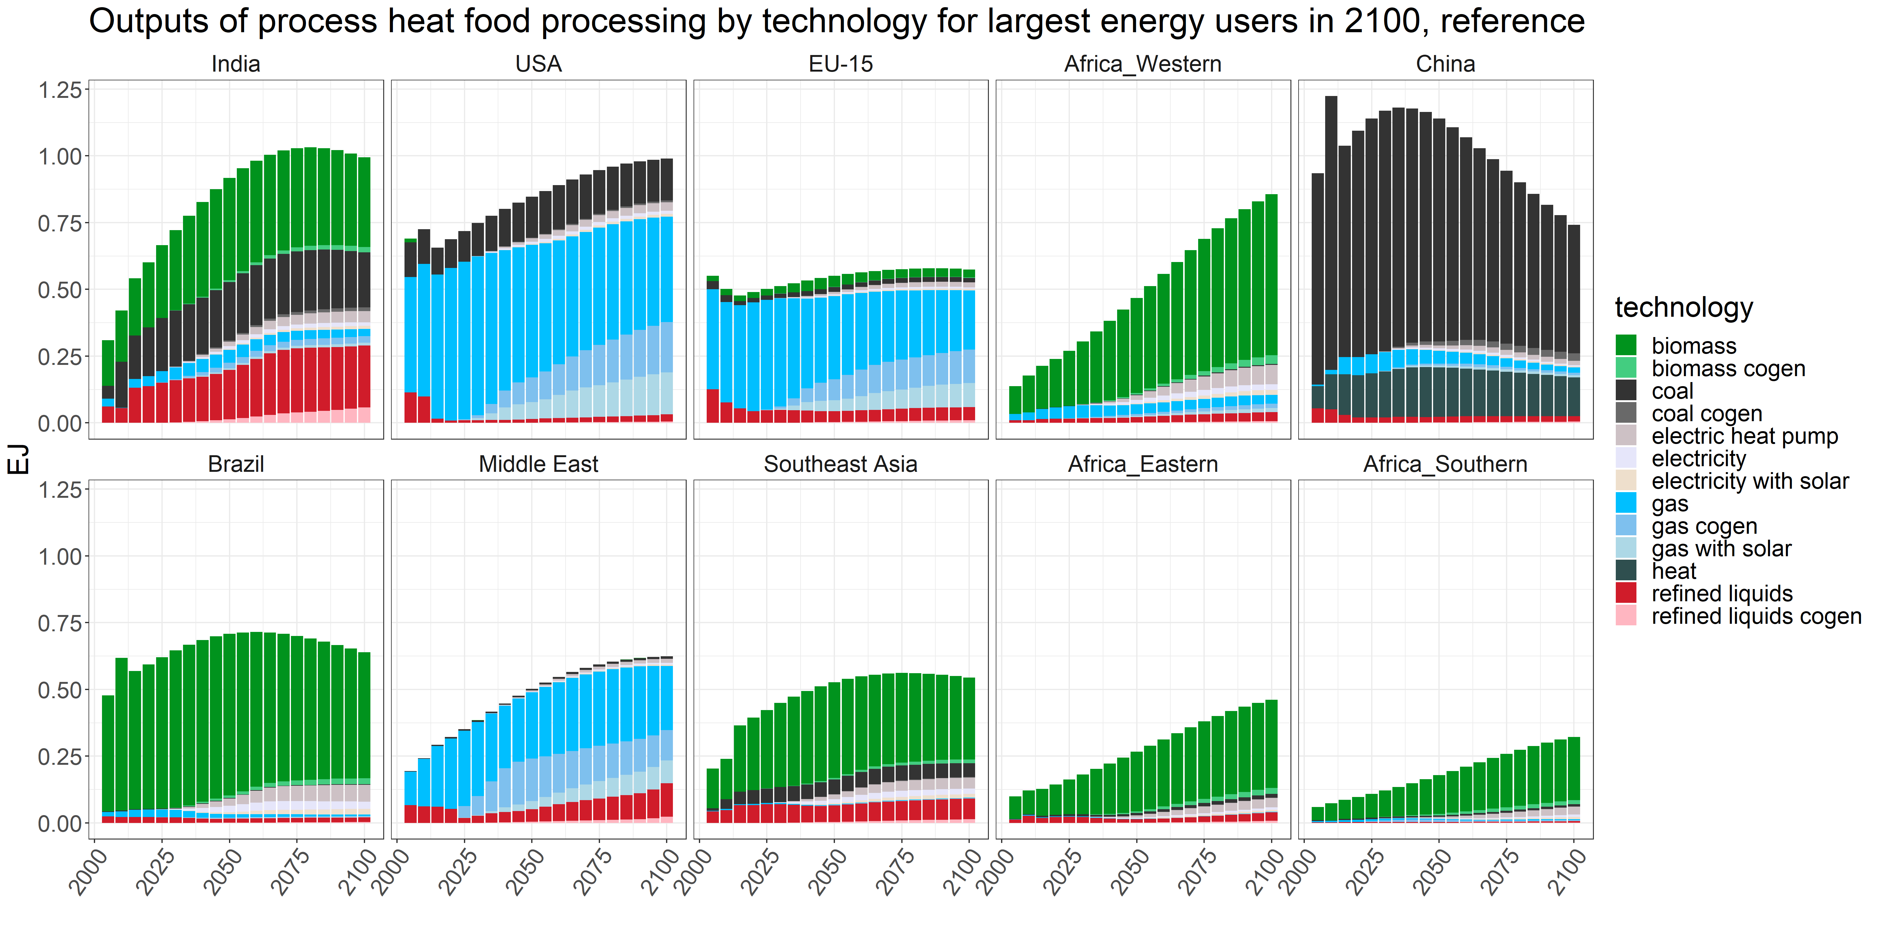
Process heat food processing outputs

Slide 16
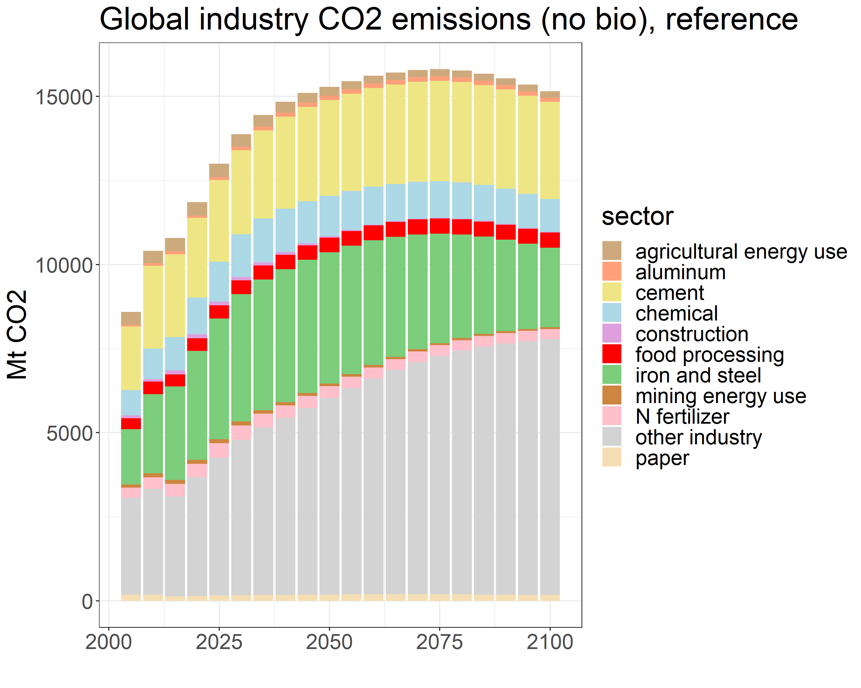
CO₂ emissions

Slide 18
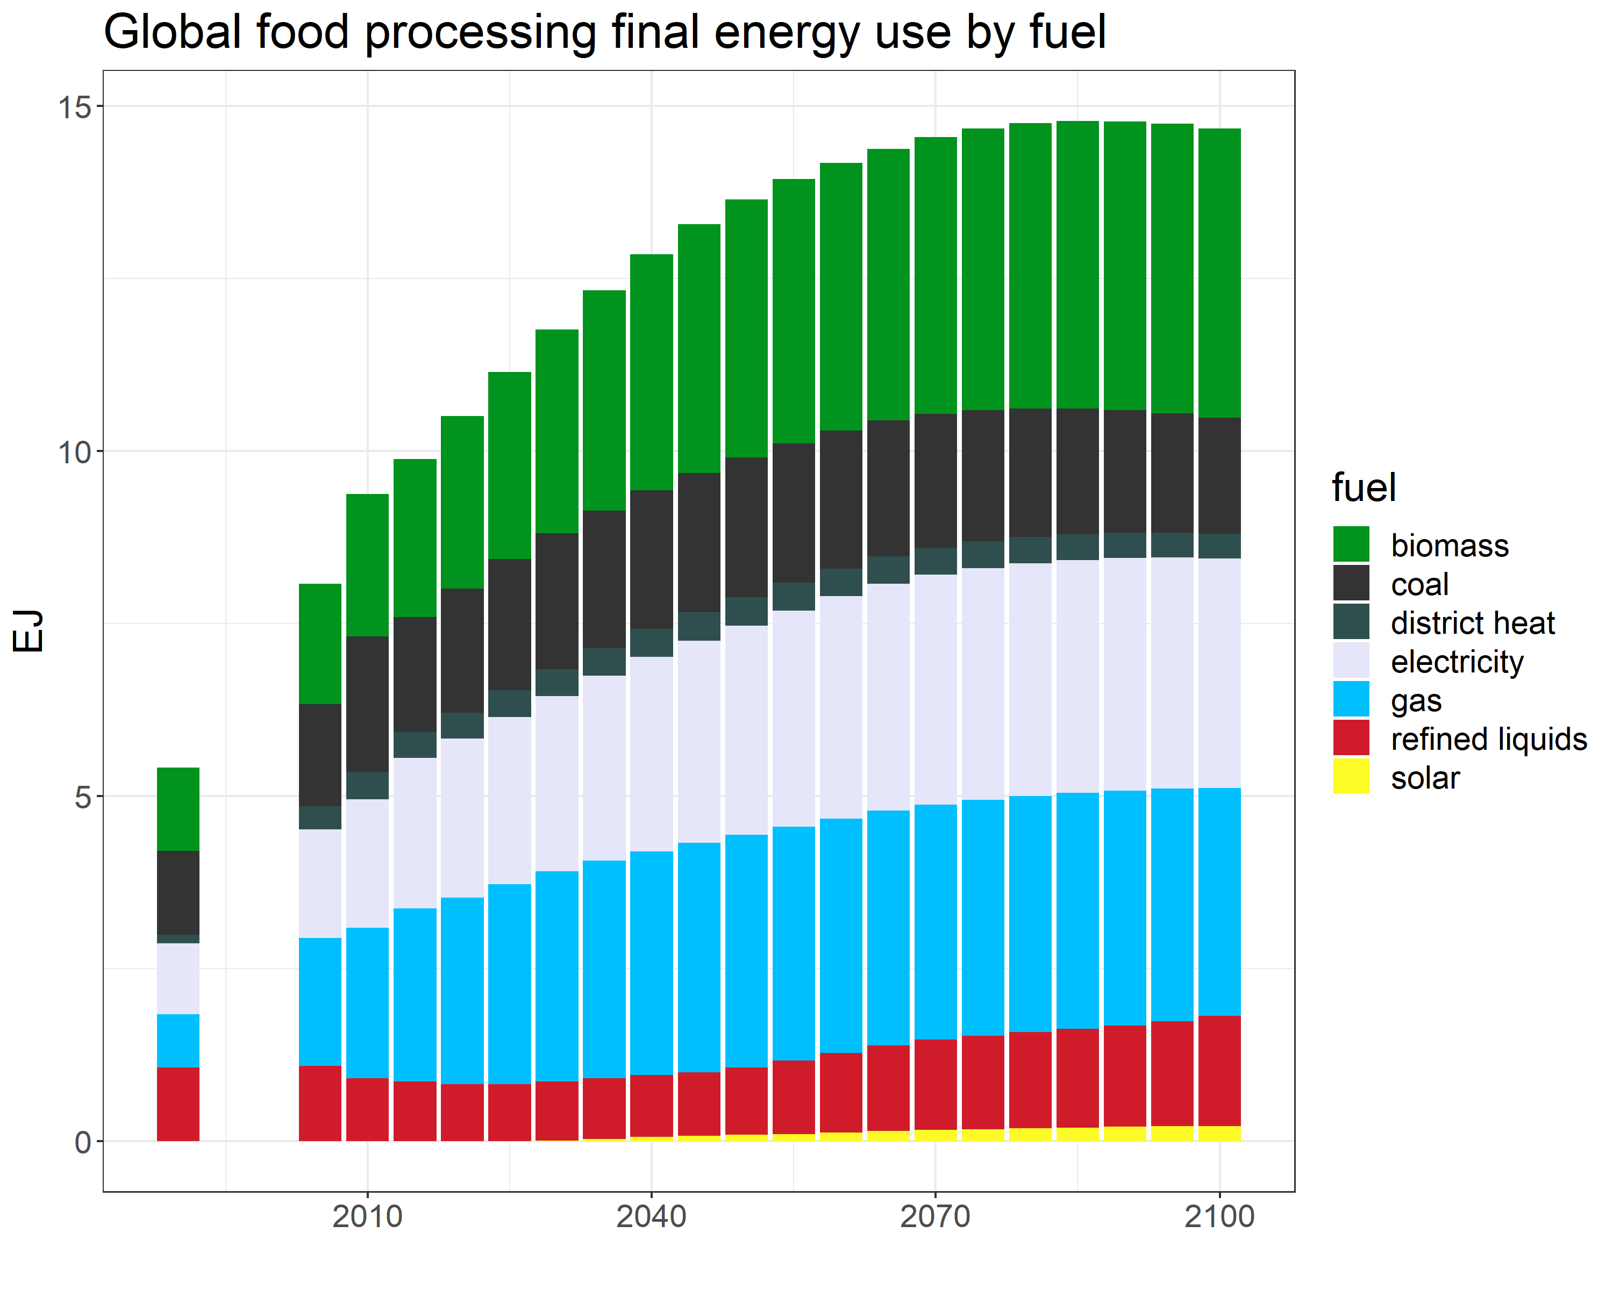
Energy use by fuel

Slide 19
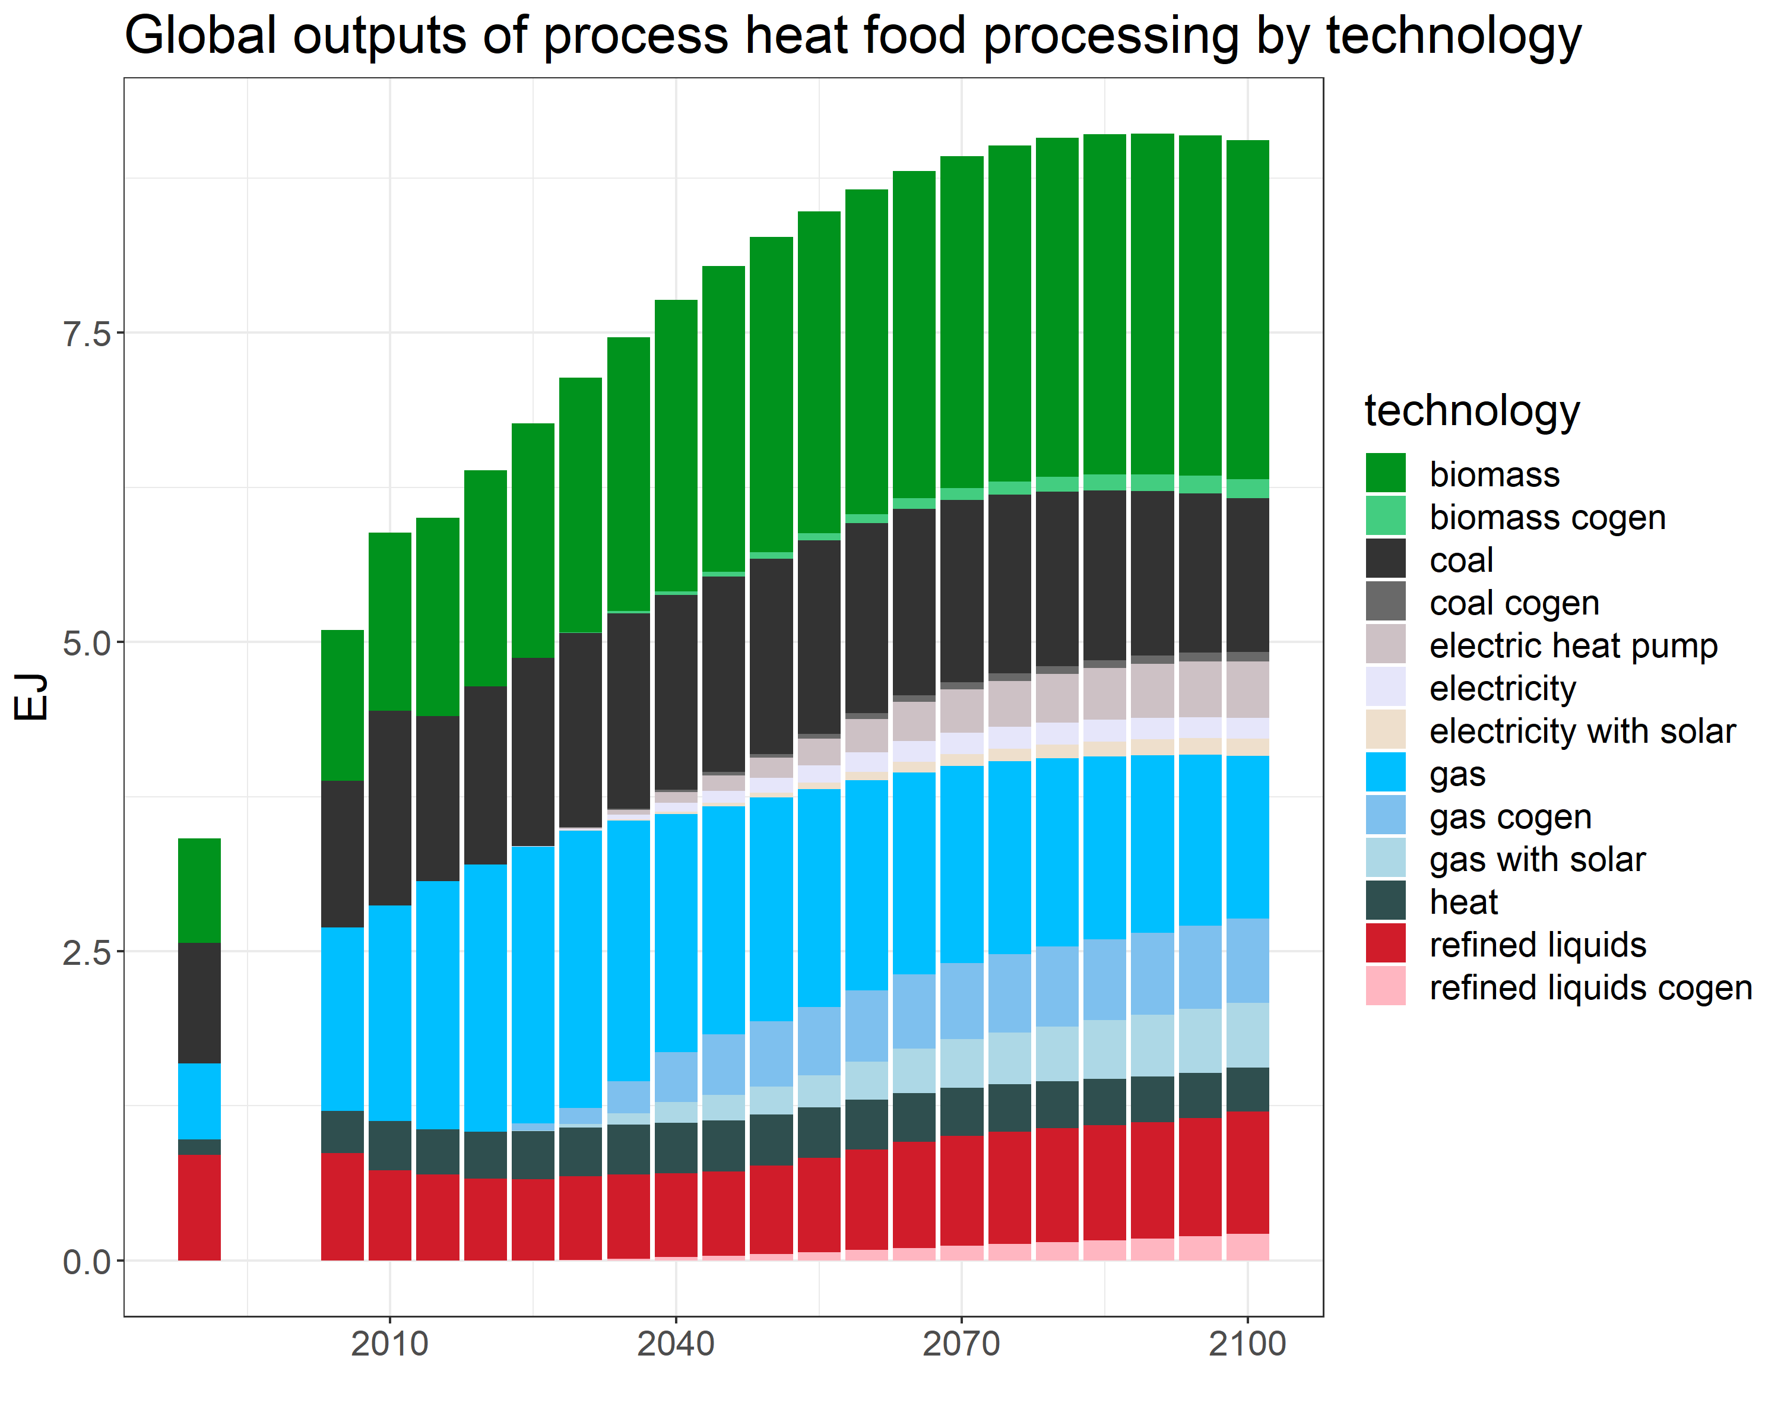
Process heat food processing outputs

